Slide 1

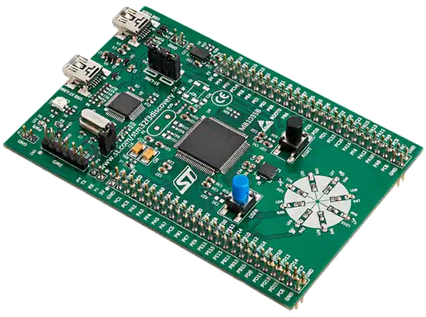

The ADC (part 1of2)
Embedded
Systems II
L18
Lecture Best
Electrical Engineering
University of Cape Town
Notes:
This lecture covers aspects of ADC design. You could have a look over this to get some insight into ADCs, but the metrics are covered in Lecture L19.
The metrics covered in these lectures are not all covered in Tut and Prac 4.
Practical understanding of ADC metrics. Tut describes a short scenario, for which you need to find an ADC that provides the required specifications.
The ADC use in the scenario is not all that fast, so SPI should work plenty fast enough for that.
In the tut it tasks about sampling at 10K samples per second (that is 1024 x 10 bytes per second to be clear). The ramp shows what the ADC would be reading.

Slide 2
Outline of Lecture
ADC – basic conceptual model
ADCs Design Flavours*
Flash ADC
Multi-stage Flash ADC
Successive Approximation ADC (SA-ADC)
Pipelined Flash ADC
* Note that there are many other design of ADCs, these slides review some of the most common approaches.
This presentation contains some slides adapted from course textbook “Embedded System Design Embedded Systems Foundations of Cyber-Physical Systems, and the Internet of Things” by Peter Marwedel

Slide 3
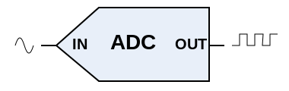
ADCs
Analogue to Digital Convertors (ADCs)

Slide 4
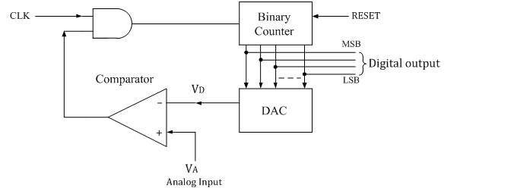

Conceptual ADC Operation
Main point: a common approach is the use of a DAC within an ADC. (why we presented DACs first)
done
The ADC is paramount in many embedded system designs. We will therefore delve into some detail of ADC issues.
Sampled analogue signal
Notes about this conceptual representation:
While this conceptual ADC could be implemented, it’s not such a practical architecture! It is very inefficient and only really useful to illustrate the operation of an ADC.
In practice, a sample-and-hold (SAH) circuit grabs the ADC input, a time-varying analogue voltage x(t), and prevents it from changing during conversion (see earlier slides on SAH).
The counter stops counting when its output, which is converted into a voltage by the DAC (digital-to-analogue converter), equals x(t), indicated by comparator. The counter output is then the ADC output code corresponding to x(t).
[2]

Slide 5
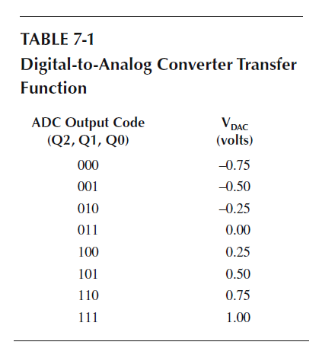
Conceptual ADC Operation
Example DAC output voltages from the changing binary counter values (i.e. the DAC’s transfer function) shown in the table below:
Basically you need to remember:
digital Output Codes corresponds to a input voltage and there will be metrics that described how these relate…
Notes about this conceptual representation:
In this conceptual design, the least significant bit (LSB), Q0, is the step size of 0.25 volts. This can also be quite an artificial assumption for a real system where the step size may fluctuate due to the physical properties of the system and environment.
[2]

Slide 6

ADCs Flavours
What flavour is your ADC?
You want Raspberry Pi flavour? Sorry, isn't a flavour; try anther. The Raspberry Pi doesn’t have a built-in ADC alas.
Analogue to Digital Convertors (ADCs)

Slide 7
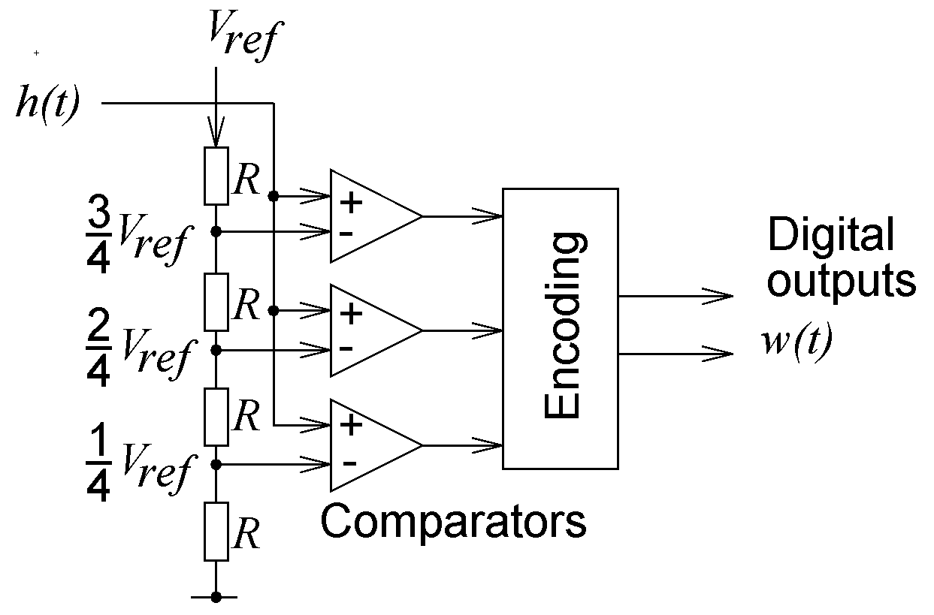
Flash ADC converter
The Flash ADC is essentially the fastest but most resource expensive and uses most power. But the power consumption is sometimes not trivial because it is done in a moment whereas the other designs use clocks and take a longer time.
Encoding of voltage intervals
“11“
“10“
“01“
No decoding of h(t) > V_{ref}
“00“
V_{ref} /4
V_{ref} /2
3V_{ref} /4
V_{ref}
h(t)

Slide 8
Resolution and speed of Flash A/D-converter
Parallel comparison with reference voltage
Speed: O(1)
Hardware complexity: O(n)
Applications: e.g. in video processing

Slide 9



Pipelined FLASH
Generally this is the best bang for your buck… but
I’m the FLASH ADC
I might be… a little heavy,
But I’m FAST!
We’re the Pipeline FLASH
We’re almost as FAST
But we’re a little cheeky!

Slide 10
But to understand the Pipeline Flash ADC
you need to first understand the SA-ADC (i.e. the Successive Approximation ADC) which is up next…
The Pipeline Flash is essentially a combination of the two

Slide 11
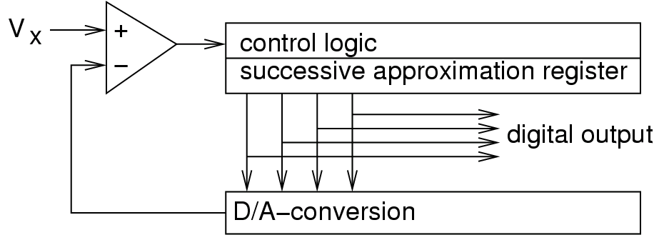
Successive Approximation ADC (SA-ADC)
h(t)
V₋
w(t)
Key idea: binary search…
Set MSB='1‘ (all other =‘0’)
if too large: reset MSB, set MSB-1='1‘
if too large:
reset MSB-1, set MSB-2=‘1’
etc..
else if too small: set MSB-1=‘1’ …
Speed: O(log₂(n))
Hardware complexity: O(log₂(n))
with n= # of distinguished voltage levels;
slow, but high precision possible.

Slide 12
Successive Approximation ADC (SA-ADC)
V
1100
1011
h(t)
V_{x}
1010
1000
V₋
t
h(t) = input analugye signal to be quantized

Slide 13
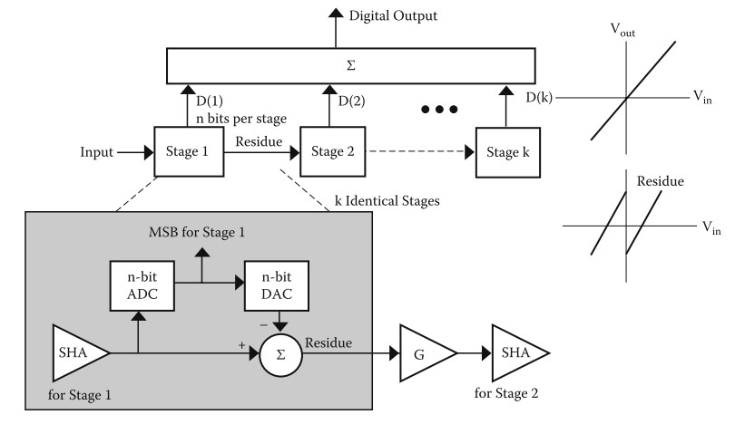
Pipelined FLASH
The conceptual operation isn’t too tricky. Stage 1 runs first and does a coarse estimate. Then stage 2 runs and does a fine estimate … but simultaneously stage 1 start a course estimate on a new sample. The key aspect here is the SHA at each stage, essentially a smaller and smaller residual moves down the pipeline until the final LSB is decided. I think it’s a really cleaver hybrid digital+analogue design!!

Slide 14
Quick Understanding Check
Q1. Does a SA-ADC usually use more comparators than a standard (i.e. ‘fat’) Flash?
Q2. Will a pipeline Flash probably be quicker than a SA-ADC? (explain your answer)
Answers…

Slide 15
Quick Understanding Check
Q1. Will a SA-ADC probably use more comparators than a standard (i.e. ‘fat’) Flash?
No. A FAT flash needs n-1 comparitors, whereas a SA-ADC, a bit slower, needs log2(n), i.e. in it pipeline of log(n) hot/cold comparators.
Q2. Will a pipeline Flash probably be quicker than a SA-ADC? (explain your answer)
Yes, it does the whole kit and caboodle in one go, faster than the SA-ADC. The voltage input to the FAT flash is tested by all n-1 comparators in one go. Whereas for the SA-ADC the voltage moves down the line being tested for too high / too low in each stage until it gets to the last stage and final bit decision.

Slide 16
References
“Embedded System Design Embedded Systems Foundations of Cyber-Physical Systems, and the Internet of Things”. Peter Marwedel (2018)
“High performance embedded computing handbook: a systems perspective”. Martinez, D., Bond, R. and Vai, M. eds. CRC Press (2008)
https://en.wikipedia.org/wiki/Aliasing
https://en.wikipedia.org/wiki/Nyquist%E2%80%93Shannon_sampling_theorem

Slide 17

The Next Episode…
Lecture L19
ADC Metrics : how good is your ADC?
(connects with tut3 and prac3)
Embedded
Systems

